Slide 1
Week 5 (2) – Breadth-First Search
CST370 – Design & Analysis of Algorithms
Dr. Byun
Computer Science

Slide 2
Lecture Objectives
After completion of this lecture, you will be able to
  perform the breadth-first search (BFS) to visit all vertices of a graph using a queue.

Slide 3
Chapter 3: Brute Force and Exhaustive Search
3.1 Selection Sort and Bubble Sort
3.2 Sequential Search and Brute-Force String Matching
3.3 Closest-Pair and Convex-Hull Problems by Brute Force
3.4 Exhaustive Search
3.5 Depth-First Search and Breadth-First Search

Slide 4
Breadth-First Search (BFS) Algorithm
At the last lecture, we talked about DFS.
  For DFS, we used a stack as a main data structure.
  For BFS, we will use a queue.
To get the basic idea of BFS, watch this video.
  https://www.youtube.com/watch?v=QRq6p9s8NVg

Slide 5
<<< Course Instruction >>>
Read pages 125-128 in the textbook and proceed to the next slide.
  The video uses a queue to describe the operation of BFS.
  In addition to a queue, our textbook also uses a “mark” for each vertex to indicate whether the vertex has already visited or not.
  Furthermore, our textbook describes the concepts of “BFS forest”, “tree edges”, and “cross edges”.

Slide 6
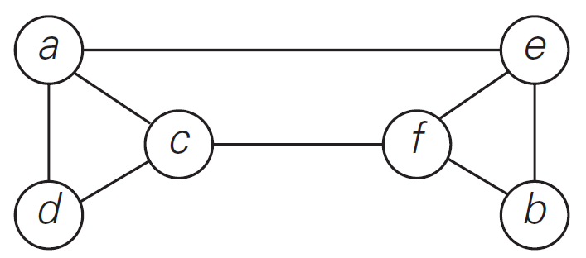
Example
Starting at the vertex a, present the sequence of vertices the BFS algorithm will visit.
  Also present a BFS tree with only "tree edges".

Slide 7
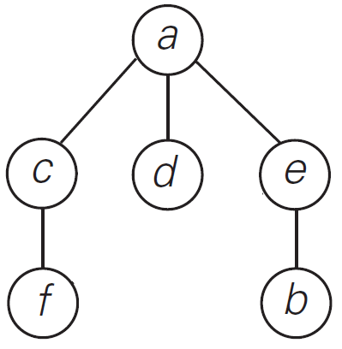
Solution
Sequence of vertices to be visited
  a → c → d → e → f → b
BFS tree with only “tree edges”.
Watch this video for detailed explanation.
  https://www.youtube.com/watch?v=-n-nyIVyUWA

Slide 8
Exercise
Starting at the vertex a, present the sequence of vertices the BFS algorithm will visit.
  Also present a BFS tree with only "tree edges".
Do not see the answer immediately.
  Try to solve it by yourself.
a
b
c
d
e
f
g
h

Slide 9
Exercise Solution
BFS Tree
a
1
a
b
2
c
6
b
e
f
d
8
e
3
g
f
4
g
5
c
h
h
7
Mark
d

Slide 10
BFS – Time Efficiency
The time efficiency of the BFS algorithm depends on the data structure used to represent the graph.
  For the adjacency matrix representation, the traversal time is in Θ(|V |²).
  For the adjacency list representation, it is in Θ(|V | + |E|) where |V | and |E| are the number of the graph’s vertices and edges, respectively.
The time efficiency of the BFS algorithm is similar to the DFS algorithm.

Slide 11
<<< Course Instruction >>>
This lecture is over.
  When you are done, study the next lecture (week_5_3.ppt) on the iLearn.

